Slide 1
Benkler et al. 2018 Network Propaganda
Two types of maps:
an open web map, which describes the hyperlinking practices of online media producers on the web.
social media maps, which describe the content sharing practices of Twitter and Facebook users.
These maps were developed using the Media Cloud platform and are based on the linking, tweeting, and sharing of just under 4 million political stories from over 40,000 online news sources.
Nodes, news sources, size indicates importance.
Edges (links) are connections between sources; the closer nodes are , the more they are linked. On social media they looked at same day shares.
Colors indicate partisanship (shares/likes by people who RT’d either Clinton or Trump).

Slide 2
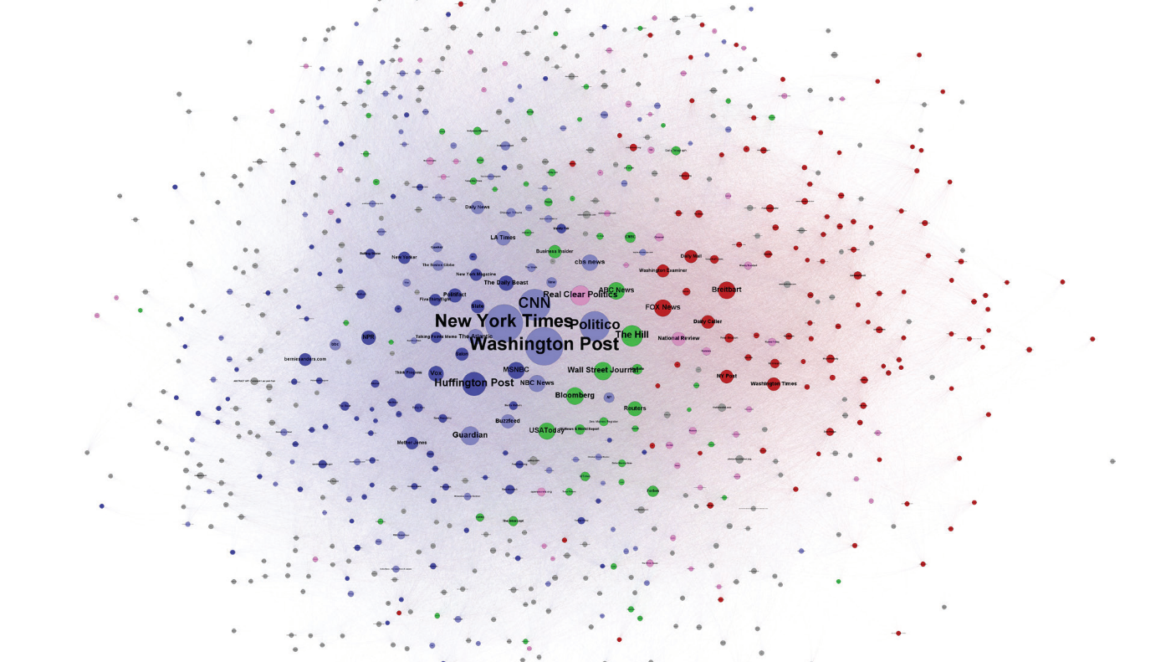

Slide 3
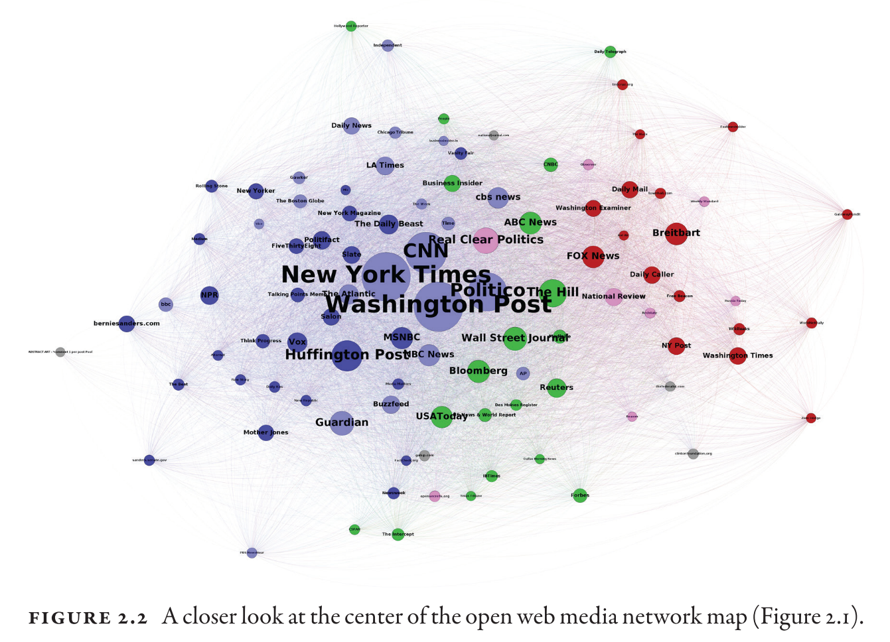

Slide 4
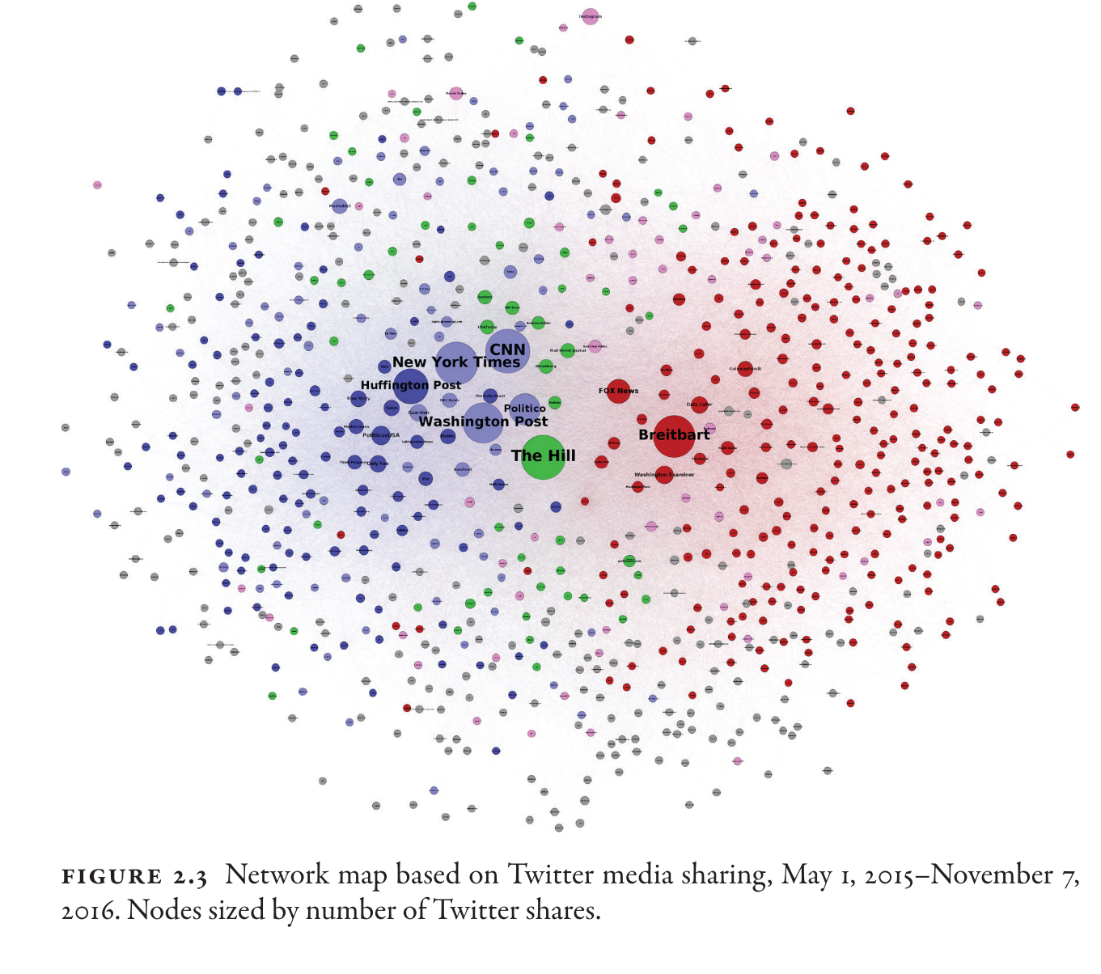

Slide 5
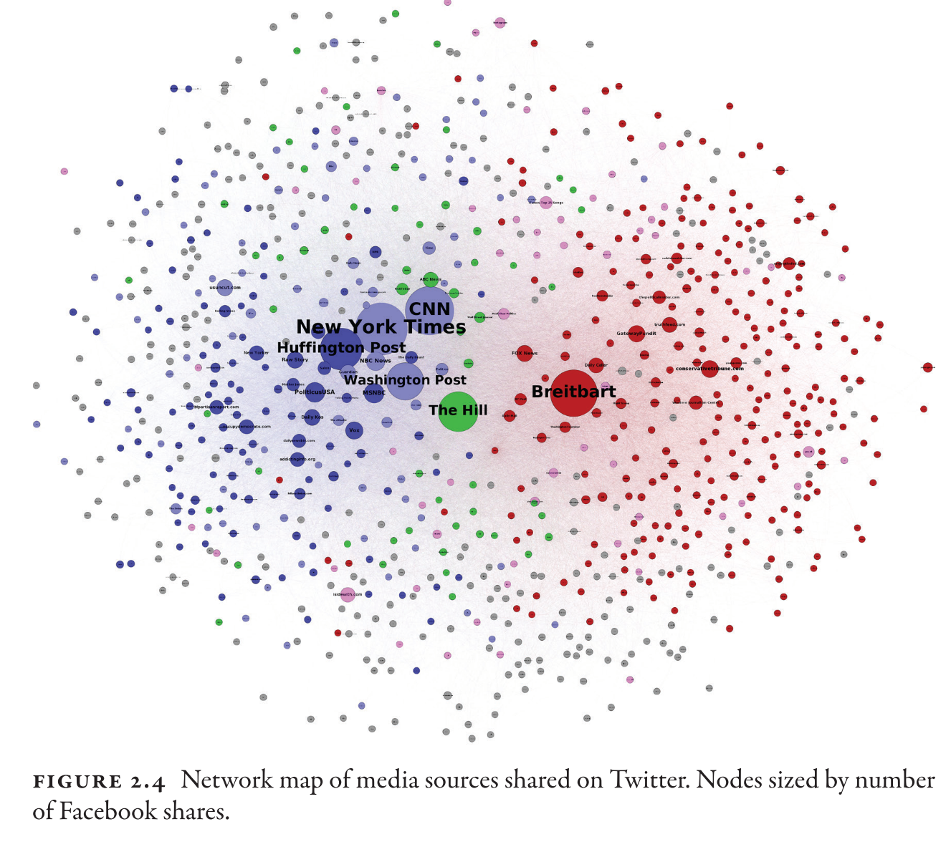

Slide 6
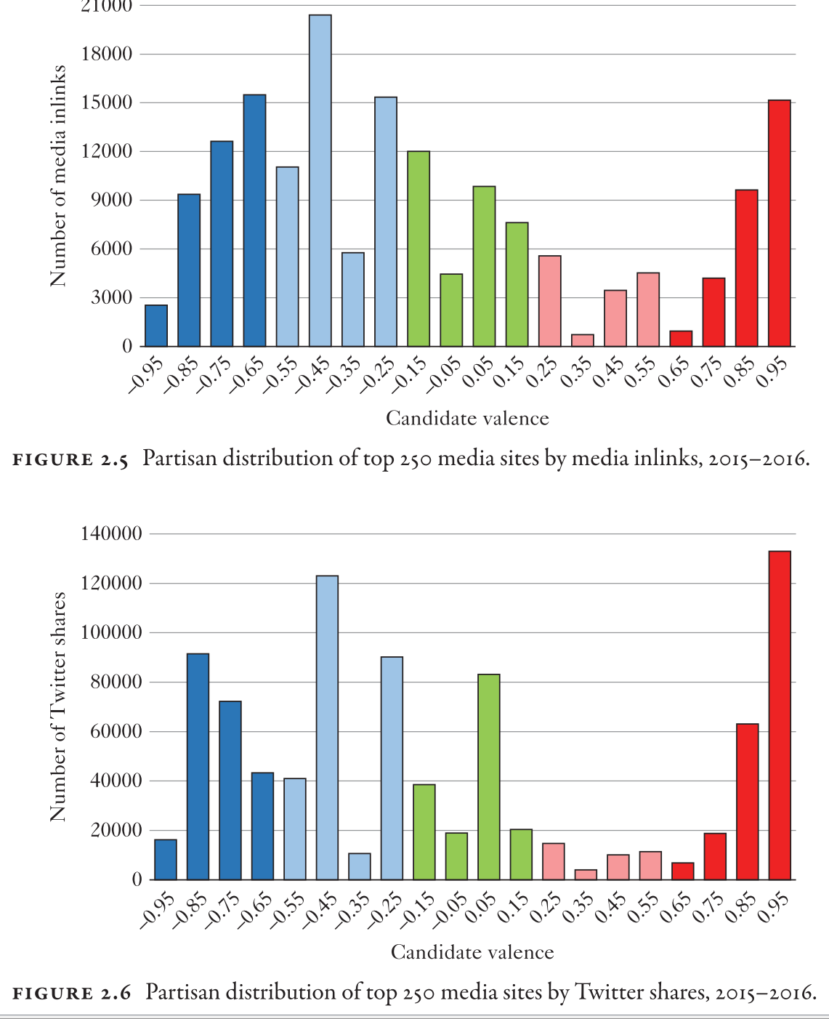

Slide 7
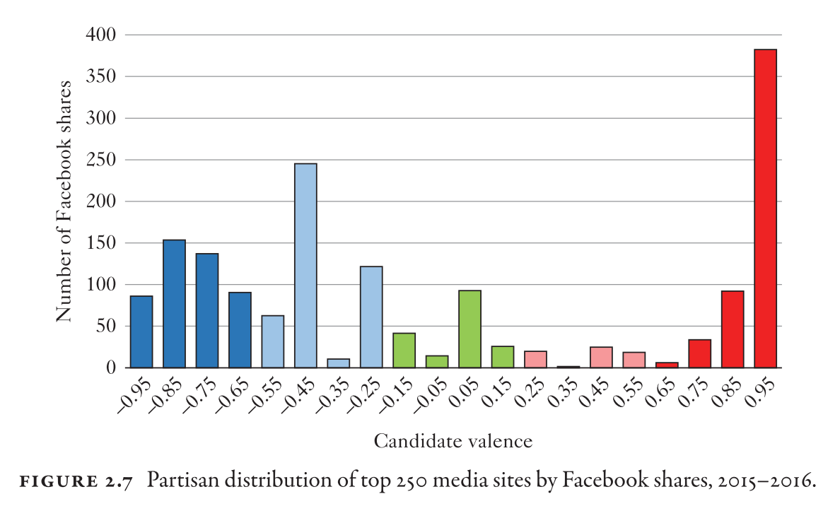

Slide 8
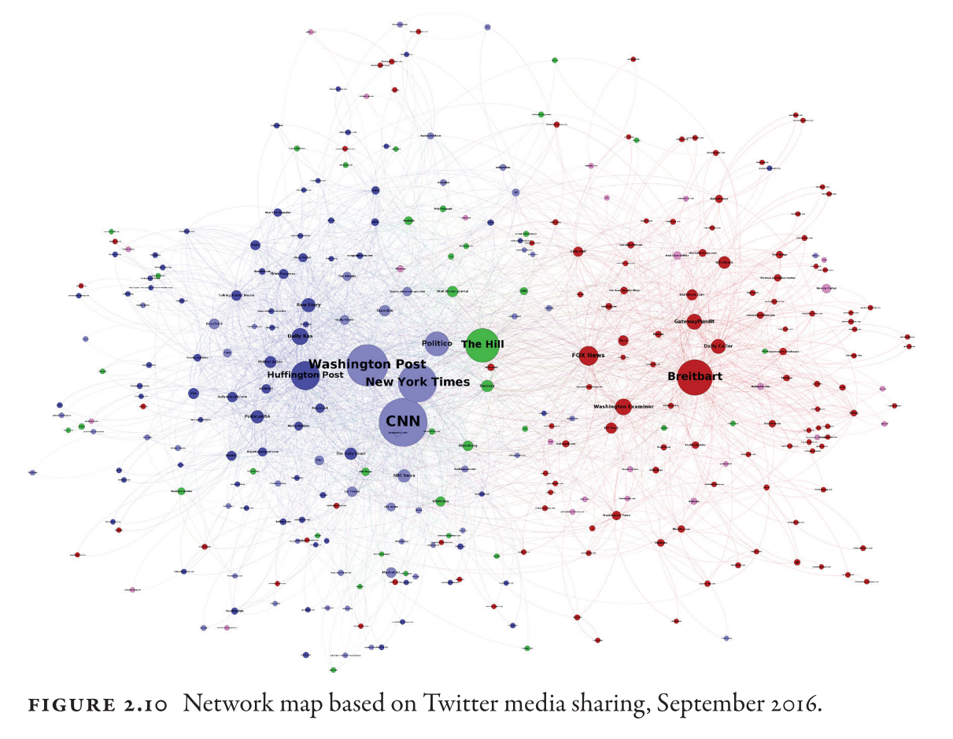

Slide 9
